Slide 1


Object Identifier
SUBJECT: IT345 SOFTWARE GROUP PROJECT- II
PRESENTED BY: DEVANSHI SHAH (16IT118) AND JAY SHAH (16IT122)
UNDER THE SUPERVISION OF PROF. JALPESH VASA

Slide 2
Flow of Presentation
What is Android?
Android Architecture
What is Object Identification?
Concept
Application

Slide 3
Configuration
Phases
Future Enhancements
References

Slide 4
What is Android?
Android is a software package and Linux based operating system for mobile devices such as tablet computers and smartphones.
It is developed by Google and later the OHA (Open Handset Alliance). Java language is mainly used to write the android code even though other languages can be used.
There are many code names of android such as Lollipop, KitKat, Jelly Bean, Ice cream Sandwich, Froyo, Eclair, Donut etc.

Slide 5
Android Architecture
Categorized into five parts:
Linux kernel
Native libraries (middleware)
Android Runtime
Application Framework
Applications

Slide 6
What is Object Identification?
Object Identification is a computer vision technique for identifying objects in images or videos.
When humans look at a photograph or watch a video, we can readily spot people, objects, scenes, and visual details.
Object Identification is a key technology behind driverless cars, enabling them to recognize a stop sign or to distinguish a pedestrian from a lamppost.

Slide 7
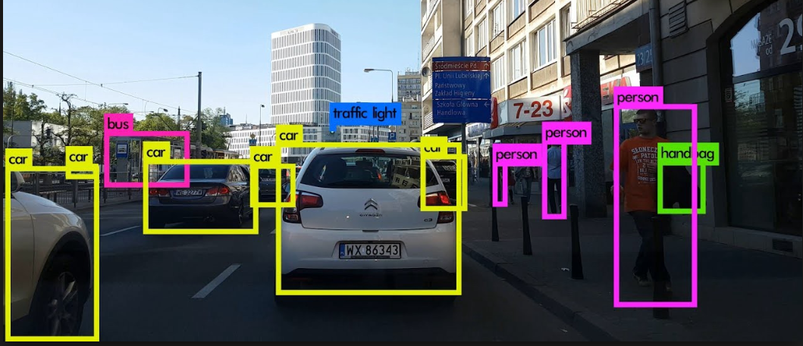
Continue…
The goal is to teach a computer to do what comes naturally to humans: to gain a level of understanding of what an image contains.

Slide 8
Concept
Every object class has its own special features that helps in classifying the class – for example all circles are round.
Object class Identification uses these special features. For example, when looking for circles, objects that are at a particular distance from a point (i.e. the center) are sought.
Similarly, when looking for squares, objects that are perpendicular at corners and have equal side lengths are needed.

Slide 9
Application
Image Retrieval
Video Surveillance
Advanced Driver Assistance systems (ADAS)

Slide 10
Configuration
Hardware:
Android Phone.
RAM:
1GB or more.
PROCESSOR:
1.2Ghz quad core

Slide 11
Continue…
Software:
DEVELOPING TOOLS:
Android Studio 3.0

Slide 12
Phases
Phase 1:
To do research and to get more information about Android IDE Development tools and create a small application to get familiar with android, as well as learn few components of camera.
Phase 2:
To develop an application which uses camera and detects the object present and on hovering on the object it identifies the object.

Slide 13
Future Enhancements
Features either the local or global used for identification can be increased, to increase the efficiency of the object identification system.
Geometric properties of the image can be included in the feature vector for recognition.
Face recognition can also be done.

Slide 14
References
https://developer.android.com/topic/libraries/architecture/
2) https://www.youtube.com/watch?v=je9bdkdNQqg
https://www.youtube.com/watch?v=taSwS5rhtmc
https://developer.android.com/guide/topics/appwidgets/

Slide 15


